Slide 1
CS3210 Lab 1
Processes, Threads and Synchronization Basics
Slides inspired by Sriram's slides

Slide 2
About myself
Yap Zhi Heng
Y3 Computer Science
Email me at yap.zhh@u.nus.edu or contact me on Telegram
I'll try to reply within 24 hours!

Slide 3

Quick admin stuff
Telegram group →
Things that are OK
Banter
Interesting finds
Lab cluster issues/requests (i.e. software installation, reporting offline machines etc.)
Things that are not OK
Code debugging help
Slides are uploaded here after every session GDrive: drive.zhiheng.dev
Remind me if I forgot to upload!
Anonymous Feedback: feedback.zhiheng.dev
All these will be shown again at the end~
Telegram Group
telegram.zhiheng.dev

Slide 4
Some ground rules…
Don't ask me for debugging help or assignment hints.
We will eventually guide you to debug parallel programs yourself!
No TA (esp. not me) will know the parallel libraries' API in micro-detail
We are not walking API dictionaries.
You will pick-up a few parallel libraries throughout CS3210, but do bear in mind all these libraries are huge!

Slide 5
The Burj Khalifa view of CS3210
Part 1: OpenMP
Making single-node CPU programs faster
Complex tasks that are relatively less parallelizable (10s of tasks)
Part 2: CUDA
Making single-node GPU-able programs faster
Simpler tasks that are relatively more parallelizable (millions of tasks even)
Part 3: MPI
Making multi-node programs faster
Large, mixed workloads (slow communication between nodes is worth it due to size / parallelizabilty of work)

Slide 6
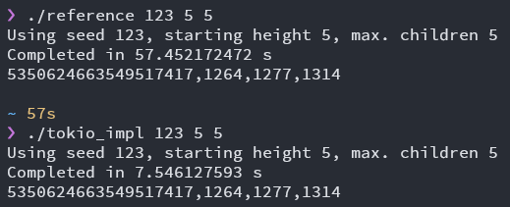
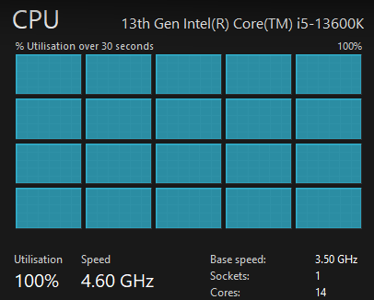
Why Parallel Computing?
Simply put: Make things go fast.
Fully utilize your systems.

Slide 7
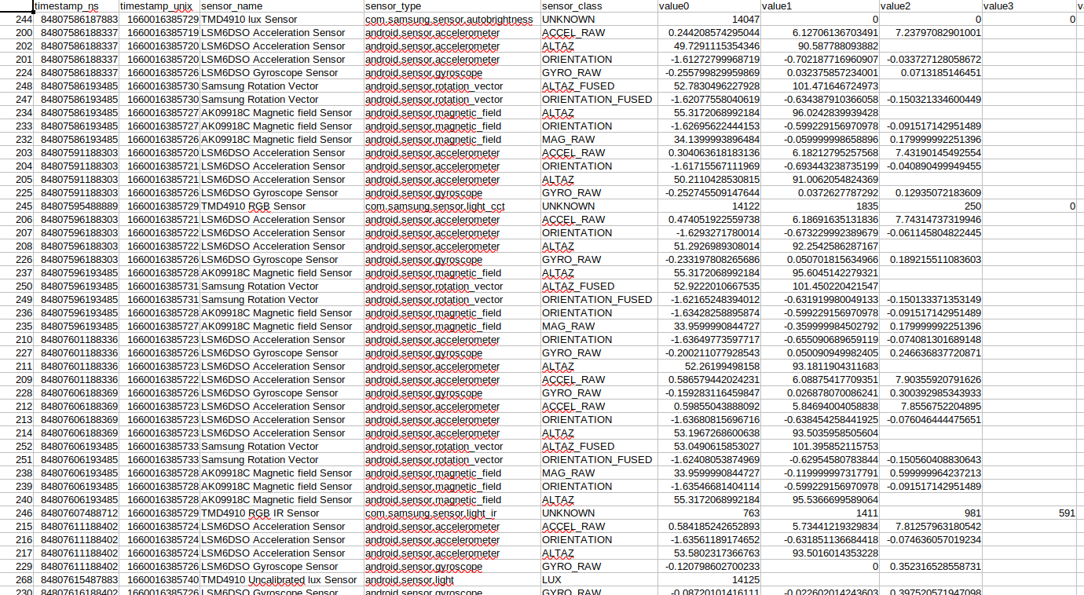
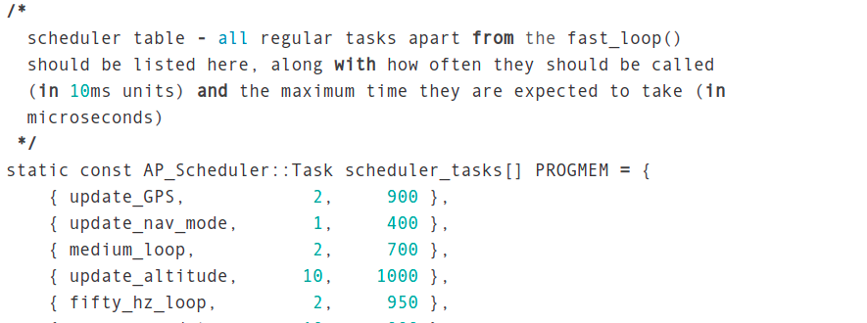
Our Goals
1. Learn to decompose problems into smaller tasks in your sleep
Data parallelism
Task parallelism
Images taken from Sriram's slides

Slide 8
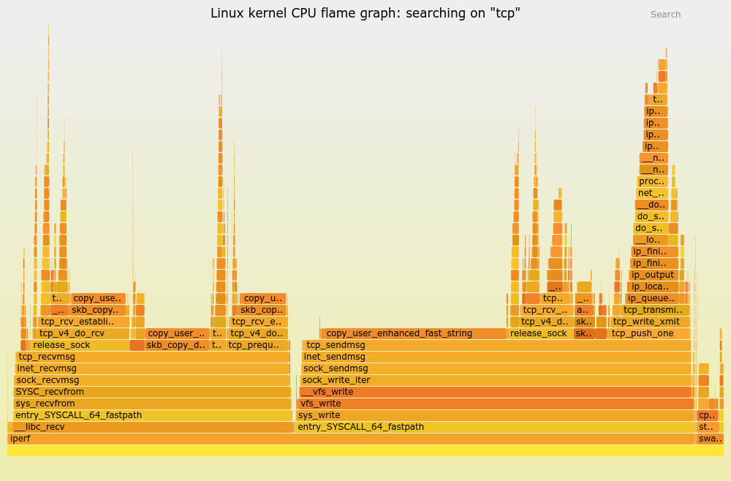
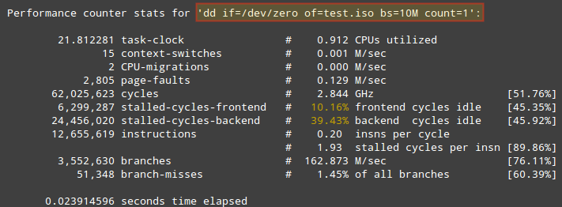
Our Goals
2. Become systems detectives: think holistically about performance
Is it the algorithm? Disk/Caching? Network? Not enough work? Too much work? Synchronization overhead?
Theory alone is useless here.
Images taken from Sriram's slides

Slide 9
Our Goals
3. Have fun!
Very satisfying to make a program faster. You will hopefully understand soon :)
GIFs taken from Sriram's slides

Slide 10
Today's Lab:
Processes, Threads & Synchronization

Slide 11

Lab 1
C-style C++ programming language
You'll eventually appreciate using C++ for your assignments later :)
Use only the pthread library. (i.e. do not use std::mutex, std::thread etc.)
Please do the lab exercises in order!
Submit exercises 7, 8 & 9 before Wed 6th Sept, 2pm via Canvas.
yesterday on /r/ProgrammerHumor…

Slide 12
Lab 1 tasks
Ex1: fork()
Ex2: pthreads order & shared variable
Extra: Semaphore usage
Ex3: Race condition
Ex4: pthread joining
Ex5: pthread mutex
Ex6: Conditional variables (will explain more later!)
Ex7: Producer-consumer: pthreads (to be submitted)
Ex8: Producer-consumer: processes & semaphores (to be submitted)
Ex9: README with explanation (to be submitted)
Visiting the PDC lab downstairs

Slide 13
Connecting to lab machines
ssh into soctf-pdc-xxx.d1.comp.nus.edu.sg (where xxx is 001-003 or 009-011)
Credentials should have been emailed to you. You will be asked to change your password on your first login.
Download lab code into the machines.
wget https://www.comp.nus.edu.sg/~srirams/cs3210/L1_code.zip
unzip L1_code.zip
For VSCode users, SSH into the node with Bash/PowerShell first to change your password before using VSCode to connect!!

Slide 14
For the more advanced users…
Use a SSH config file: (Add this to ~/.ssh/config, works with VSCode too)
Host soctf
Hostname soctf-pdc-009.d1.comp.nus.edu.sg
User [Your user name]
ForwardAgent yes
You can now just type ssh soctf to SSH into the server~

Slide 15
For the more advanced users…
Use a SSH key (instead of password)
Enter ssh-keygen into your command prompt
Follow the instructions to generate a key
Upload the .pub key at https://pdc.comp.nus.edu.sg/
Use the other file generated (i.e. your secret key) to ssh!
SSH config file w/ key:
Host soctf
Hostname soctf-pdc-009.d1.comp.nus.edu.sg
User [Your user name]
ForwardAgent yes IdentityFile ~/.ssh/id_rsa

Slide 16
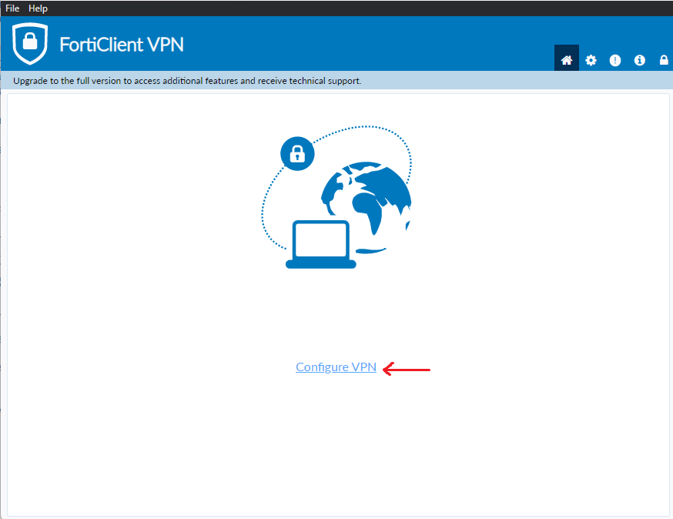
Accessing the machines while not being at SoC…
More important for your assignments, you do not have to do this for this lab.
https://www.fortinet.com/support/product-downloads → Install Forticlient VPN
After installation: Click on Configure VPN
Further reference: https://dochub.comp.nus.edu.sg/cf/guides/network/vpn

Slide 17
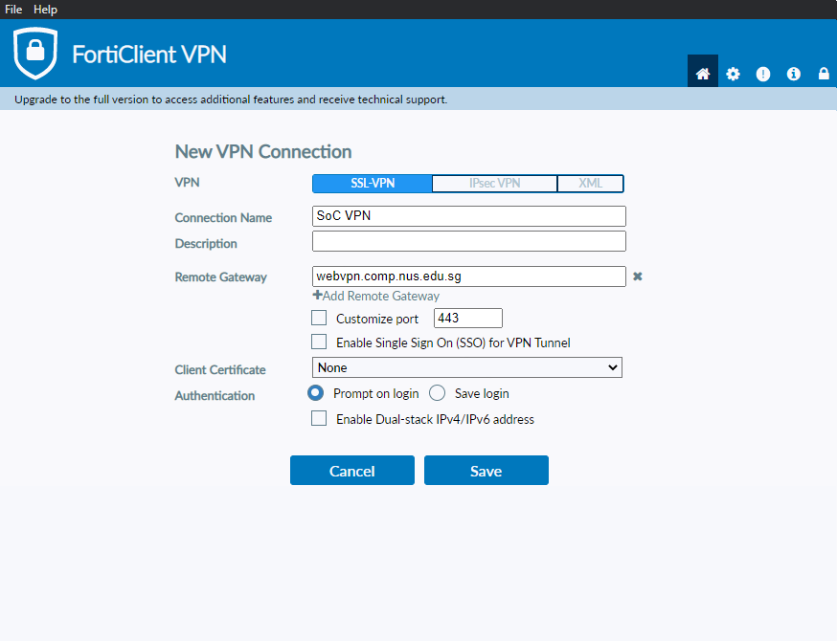
Forticlient VPN Configuration
Ensure VPN is SSL-VPN
Connection Name: SoC VPN
Remote Gateway: webvpn.comp.nus.edu.sg
Authentication can be either one.

Slide 18
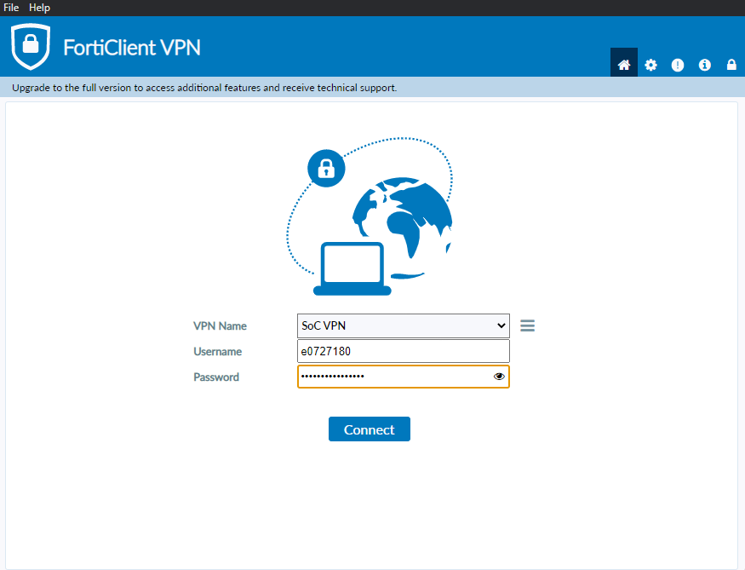
Logging into the VPN
Use your NUS Credentials to login!

Slide 19
Named vs Unnamed Semaphores

Slide 20
Named vs Unnamed Semaphores
Named semaphores (created with sem_open) are "automatically shared between processes" - how?
Processes duplicate their memory spaces on fork()
Parent process executes:
sem_t* sem = sem_open("pSem", O_CREAT | O_EXCL, 0644, value);
So shouldn't the semaphore be private to each process?

Slide 21
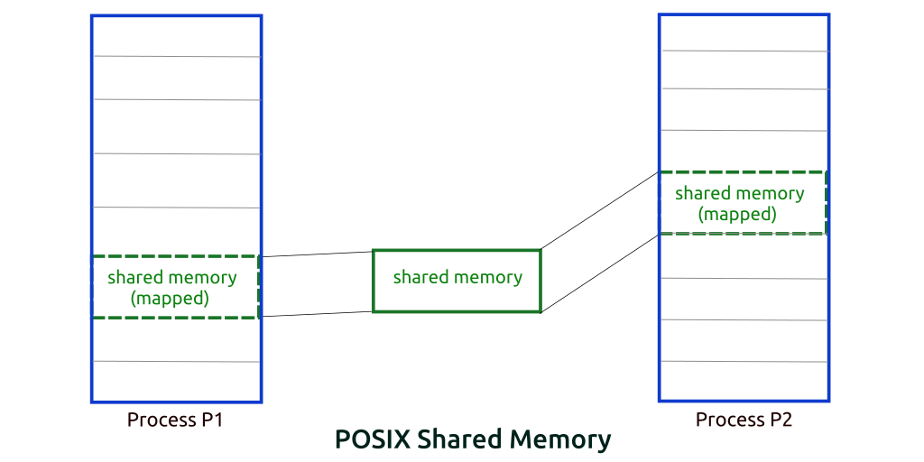
Named vs Unnamed Semaphores
So shouldn't the semaphore be private to each process?
OS automatically maps semaphore into shared memory!
Try:
./semaph
Ctrl+Z after entering sem value
ipcs; ls /dev/shm
fg; Ctrl-C; ipcs ; ls /dev/shm
To delete shared memory space: ipcrm -M <shm-key>
To delete the semaphore: rm /dev/shm/<sem-name>
`pSem`

Slide 22
Shared memory usage
You may have allocated things in shm within your process and terminated it prematurely before it can clean it up.
Commands to resolve it:
ipcs -cm | Checks shared memory usage on the machine
ipcrm -M <key> | Delete the memory area
ls -la /dev/shm | Check whether there are any named semaphores in the system
rm /dev/shm/<sem> | Remove the named semaphore

Slide 23
Binary Semaphores vs pthread mutexes

Slide 24
Binary Semaphores vs pthread mutexes
What is the difference?

Slide 25
Binary Semaphores vs pthread mutexes
Consider the following scenario:
Thead 1 calls sem_wait on sem and enters critical zone
Thead 2 calls sem_post on sem
time
sem = 1
sem = 0
sem = 1

Slide 26
Binary Semaphores vs pthread mutexes
Consider the following scenario:
Thead 1 locks mut and enters critical zone
Thead 2 unlocks mut
time
mut = unlocked
mut = locked
???

Slide 27
Binary Semaphores vs pthread mutexes
Consider the following scenario:
Thead 1 locks mut and enters critical zone
Thead 2 unlocks mut
time
mut = unlocked
mut = locked
UNDEFINED BEHAVIOUR

Slide 28
Binary Semaphores vs pthread mutexes
What is the difference?
Any thread can wait/post on a semaphore
Only the thread that locked a pthread mutex can unlock it

Slide 29
Condition Variables

Slide 30
Condition Variables
Waiting thread:
pthread_mutex_lock(&mutex);
while(condition not satisfied) {
pthread_cond_wait(&cond_var, &mutex);
}
pthread_mutex_unlock(&mutex);
Signaling Thread
pthread_mutex_lock(&mutex)
/* change variable value */
if (condition satisfied) {
pthread_cond_signal(&cond_var);
}
pthread_mutex_unlock(&mutex);
Handles "spurious wakeups"
Releases mutex when waiting on cond_var
At this point, mutex is re-obtained
Tells the waiting thread to wake up, but thread will only wake up once the signaling thread releases mutex.

Slide 31
Condition Variables
We ask you to use condition variables in ex7 and semaphores in ex8 to do the same thing.
So both of them seem to have similar functionality.
Why do they both exist?

Slide 32
Condition Variables
Why do they both (condition variables, semaphores) exist?
Semaphores are too generic (i.e. only increment & decrement operations) to map nicely to all problems.
Semaphores cannot broadcast messages to other threads, but condition variables can.

Slide 33
Spurious Wakeups
Why do we not use if statements for checking condition in the waiting thread?
Waiting thread:
pthread_mutex_lock(&mutex);
if (condition not satisfied) {
pthread_cond_wait(&cond_var, &mutex);
}
pthread_mutex_unlock(&mutex);
Signaling thread:
pthread_mutex_lock(&mutex)
if (condition satisfied) {
pthread_cond_signal(&cond_var);
}
pthread_mutex_unlock(&mutex);

Slide 34
Spurious Wakeups
Another waiting thread may snipe the mutex after the signaling thread releases the mutex.
😈Evil waiting thread:
// Obtains mutex here after signaling thread unlocks it, so
// the waiting thread cannot obtain the mutex & carry on.
pthread_mutex_lock(&mutex);
// condition is satisfied due to signaling thread's updates,
// so the if-statement is skipped
if (condition not satisfied) {
pthread_cond_wait(&cond_var, &mutex);
}
/* Do something here to make condition invalid again */
pthread_mutex_unlock(&mutex);
// Mutex is released to the other waiting thread 😈
Notes:
https://en.wikipedia.org/wiki/Spurious_wakeup

Slide 35
Summary
Connecting to lab machines
Processes and threads
Mutexes/Semaphores/Condition Variables
Bringing it all together

Slide 36
End of Lab 1
Email: yap.zhh@u.nus.edu
Slides are uploaded here after every session GDrive: drive.zhiheng.dev
Anonymous Feedback: feedback.zhiheng.dev
PDC Lab Visit commencing…
Telegram Group
telegram.zhiheng.dev

